Slide 1
Logistic regression
Overview
Maths – intuition

Slide 2
Multinomial Logistic Regression
Binary Classification:
Given the subject and the email text predicting, Email Spam or not.
Sunny or rainy day prediction, using the weather information.
Based on the bank customer history, Predicting whether to give the loan or not.
Multi-Classification:
Given the dimensional information of the object, Identifying the shape of the object.
Identifying the different kinds of vehicles.
Based on the color intensities, Predicting the color type.

Slide 3
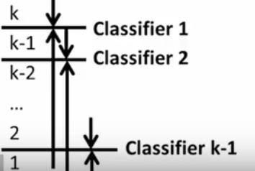
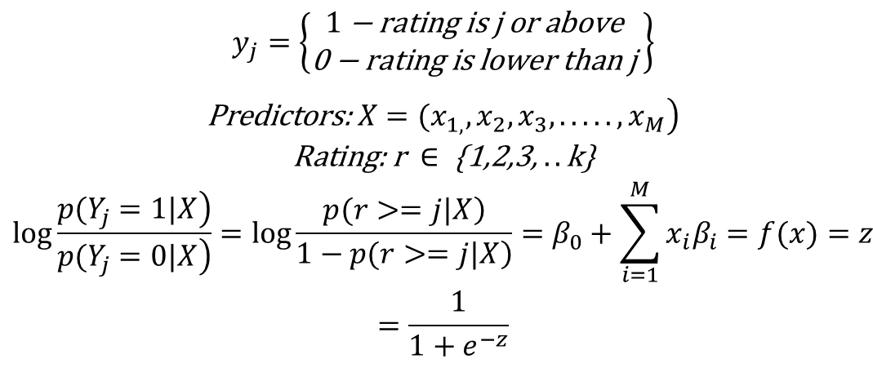
How does it work?
$$\begin{matrix}y_{j}=\left\{\begin{matrix}1\text{ − }\text{rating} \text{is} \text{j} \text{or} \text{above} \\ \text{0 − }\text{rating} \text{is} \text{lower} \text{than} \text{j} \end{matrix}\right\} \\ \\ \left.\text{Predictors}\text{: }X=(x_{1,},x_{2},x_{3},.....,x_{M}\right) \\ \text{Rating}\text{: }\text{r} ∈\text{ \{1,2,3, }..\text{k}\text{\}} \\ log\frac{\left.p(Y_{j}=1|X\right)}{\left.p(Y_{j}=0|X\right)}=log\frac{\left.p(r>=j|X\right)}{\left.1−p(r>=j|X\right)}=β_{0}+\sum_{i=1}^{M}{x_{i}β_{i}}=f(x)=z \\ =\frac{1}{1+e^{−z}} \\ \end{matrix}$$

Slide 4
Essentially …
P(r >=k|X > 0.5?
P(r >=k-1|X > 0.5?
P(r >=k-2|X > 0.5?
P(r >=k-3|X > 0.5?
…
…
YES
r = k
No
YES
r = k -1
No
YES
r = k - 2
No
No
No
YES
r = 1

Slide 5
Difference Between Sigmoid Function & Softmax Function
Softmax Function | Sigmoid Function
Used for multi-classification in logistic regression model. | Used for binary classification in logistic regression model.
The probabilities sum will be 1 | The probabilities sum need not be 1.
Used in the different layers of neural networks. | Used as activation function while building neural networks.
The high value will have the higher probability than other values. | The high value will have the high probability but not the higher probability.

Slide 6
sklearn.linear_model.LogisticRegression
class sklearn.linear_model.LogisticRegression(penalty=’l2’, dual=False, tol=0.0001, C=1.0, fit_intercept=True, intercept_scaling=1, class_weight=None, random_state=None, solver=’warn’, max_iter=100, multi_class=’warn’, verbose=0, warm_start=False, n_jobs=None)
multi_class : str, {‘ovr’, ‘multinomial’, ‘auto’}, default: ‘ovr’
If the option chosen is ‘ovr’, then a binary problem is fit for each label.

